Slide 1
INFORMATION SECURITY PROJECT
Group 03 • Batch 2024
Secure Library Management System
Digitizing library operations while maintaining Confidentiality, Integrity, and Access Control (CIA).
TEAM MEMBERS
SUBMITTED TO
Ayesha Shaikh • Sharjeel Ahmed • Syed Abdul Wahab
Dean Dr. Zahoor Shah

Slide 2


FOUNDATION
Project Aim & Core Objective
Security-First Architecture
Operational Efficiency
Protecting records from unauthorized access while automating digital borrowing workflows.
Replacing manual paper registers with instant catalog searches and transparent role-based dashboards.
Core Principle: Upholding Confidentiality, Integrity, and Access Control (CIA) across all library transactions.

Slide 3
CHALLENGES
Limitations of Traditional Library Systems
Manual Registers
Security Risks
Tracking Delays
Prone to physical loss, damage, and inconsistency.
Student & teacher records exposed to unauthorized access.
Hard to verify book availability or track due dates.
Search Inefficiency
Administrative Burden
Report Generation
Finding specific titles takes significant manual effort.
Librarians spend excessive time on routine paperwork.
Accurate borrowing statistics are difficult to compile.
Solution: Centralized web application with authenticated role-based access.

Slide 4



ARCHITECTURE
Three-Tier Architecture & Technology Stack
Presentation Layer
Application Layer
Database Layer
HTML5, CSS3, Bootstrap, JavaScript
PHP Server Logic & Business Rules
MySQL Relational Database
DEVELOPMENT ENVIRONMENT
CODE EDITOR
VERSION CONTROL
XAMPP Local Server
Visual Studio Code
Git & GitHub Repository

Slide 5
ACCESS CONTROL
User Roles & Server-Side Permissions
Student Role
Librarian Role
Administrator Role
Self-registration, catalog search, borrowing requests, return requests, and personal loan history.
Inventory management, adding/editing books, approving borrowing requests, and recording physical returns.
User account management, role assignments, audit logs, reports, CSV export, and loan policy settings.
Enforced via server-side session checks () to prevent unauthorized privilege escalation.
require_role()

Slide 6
SECURITY DESIGN
Information Security Safeguards
Password Hashing
Prepared Statements
Secured using PHP with PASSWORD_DEFAULT.
PDO queries with emulated prepares disabled to mitigate SQL injection.
password_hash()
CSRF Protection
Login Throttling
Token validation applied across state-changing POST form requests.
Brute-force mitigation tracking failed attempts per email and IP address.
activity_logs
Maintains Audit Trails via for accountability and tracking.

Slide 7
DATABASE SCHEMA
Relational Database Structure (`secure_library`)
Users Table
Books & Categories
Borrowings Table
Stores user accounts, hashed passwords, roles (Student/Librarian/Admin), and active status.
Manages book inventory, ISBNs, categories, total copies, and available copy counts.
Tracks issue dates, due dates, return dates, and transaction statuses (pending, borrowed, returned).
Foreign Keys: Referential integrity across tables
Stock Constraint: Available copies ≤ total copies

Slide 8

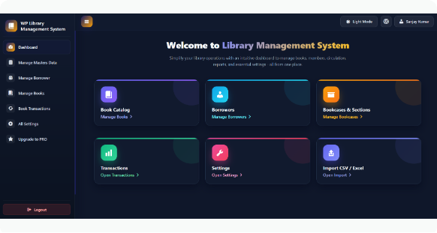
SYSTEM EVIDENCE
Screenshot Analysis: Authentication & Throttling
Role-Based Sign-In & Registration
Verifies email credentials via and regenerates session IDs.
password_verify()
Login Throttling & Error Alerts
Blocks brute-force attempts after 5 failures per IP/email and records failed events.
CSRF tokens protect every login, registration, and password submission form.

Slide 9

SYSTEM EVIDENCE
Screenshot Analysis: Admin Control & Audit Logs
Account & Role Governance
Admins assign Student, Librarian, or Admin roles and toggle account activation status.
Audit Trails & CSV Reports
Logs IP addresses, timestamps, and user actions with one-click CSV data exports.
Global System Policy: Max 3 active loans per user • 14-day default loan duration.
Admin Governance

Slide 10
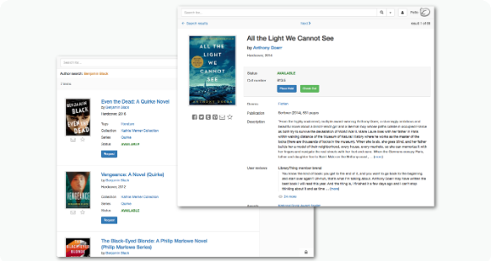
SYSTEM EVIDENCE
Screenshot Analysis: Librarian Catalog & Loans
Inventory & ISBN Control
Add or update titles, authors, categories, and copy counts with atomic stock checks.
Approval & Return Workflow
Approve pending requests, assign due dates, and restore inventory upon physical return.
Referential integrity blocks deletion of books linked to active or historical borrowing records.

Slide 11
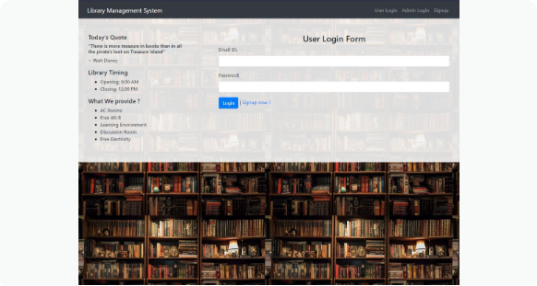
SYSTEM EVIDENCE
Screenshot Analysis: Student Portal & Borrowings
Instant Catalog Discovery
Filter real-time book availability by title, author, category, or ISBN number.
Self-Service Loan Tracking
Submit borrow/return requests and monitor due dates from a personal dashboard.
Automatic validation prevents duplicate requests and enforces the 3-book active loan cap.

Slide 12
SYSTEM EVIDENCE
Screenshot Analysis: Administrator Dashboard
User Management
Activity Audit Logs
Reports & CSV Export
Admin panel for creating accounts, updating roles, and setting active/inactive status.
Inspects sign-in events, timestamps, and IP addresses for accountability.
Summarizes borrowing activity and supports downloading transaction records.
Configurable System Settings: Default 3 active loans limit & 14-day loan period.
Admin Control

Slide 13
SYSTEM EVIDENCE
Screenshot Analysis: Librarian Operations
Book Catalog Maintenance
Transaction Management
Librarian interface for adding new book titles, editing metadata, and updating available copy counts.
Reviewing pending borrowing requests, approving/rejecting loans, and recording physical returns.
Ensures referential integrity: book deletions are restricted when active borrowing history exists.

Slide 14
SYSTEM EVIDENCE
Screenshot Analysis: Student Portal & Catalog
Catalog Search
Borrowing Requests
My Borrowings
Allows students to search and filter books by title, author, category, or ISBN instantly.
Students submit borrowing requests for available titles, displaying green confirmation status badges.
Personal dashboard tracking active loans, due dates, and return request submissions.
Delivers an intuitive, user-friendly interface optimized for students and academic staff.

Slide 15
SUMMARY & OUTLOOK
Conclusion & Future Enhancements
Project Outcomes
Future Roadmap
Successfully digitized library operations, minimized manual paperwork, enforced role-based security, and maintained CIA across all records.
Planned upgrades include barcode/RFID scanning, automated email reminders, fine calculations, and mobile application access.
GitHub Repository: https://github.com/ayeshashaikh-019/secure-library-management-system
Thank You! Q&A Session

